Slide 1
echo ‘G5T4’;
Progress Update
Jaslyn, Leonard, See Hoe, Yi Bing, Serene

Slide 2
Functionality Update
01
Schedule Update
02
Bug Metrics
TABLE OF CONTENTS
03
Roles and Responsibilities
04
Pair Programming and Rotation Plan
05
NEW: Bid ->Section + Admin Clearing + Drop a Bid + View bidding results
Included Iteration 6
Updated Bug Metrics
New Roles for Iteration 6
New Rotation to include Iteration 6, New rotation for iteration 4 and 5

Slide 3
01
Functionality Update

Slide 4
Functionalities Not planning to drop any, No PHP Frameworks
Completed
Login for Student and Admin (http://18.221.10.143/app/Login.php)
Bootstrap for Admin
Bid for ->Section (*NEW)
Admin Clearing Round 1 and 2 (*NEW)
Drop a bid (*NEW)
View Bidding Results (*NEW)
Cloud deployment:
Admin Password: Help@123
IP Address: 18.221.10.143
Currently in Iteration 3 Progress:
Drop ->Section
JSON checkers

Slide 5
02
Schedule Update
New: Iteration 6

Slide 6
Bird’s Eye View on Schedule
Iteration 1 (PM Jaslyn):
14 Sep - 27 Sep
Days: 14
Iteration 3 (PM See Hoe) :
12 Oct - 25 Oct
Days: 14
Iteration 5 (PM Serene):
9 Nov- 17 Nov
Days: 9
Iteration 2 (PM Leonard):
28 Sep - 11 Oct
Days: 14
Iteration 4 (PM Yi Bing):
26 Oct - 8 Nov
Days: 14
*NEW Iteration 6 (PM Jaslyn):
18 Nov - 21 Nov
Days: 4

Slide 7
Planned Iterations
Iteration | Start | End | Weeks
1 | 14-Sep (We started early) | 28-Sep | 4,5,6
2 | 28-Sep | 11-Oct | 6, 7 (PM Review),8
3 | 12-Oct | 25-Oct | 8, 9 (Online Review),10
4 | 26-Oct | 8-Nov | 10, 11 (UAT),12
5 | 09-Nov | 17-Nov | 12, 13 (Project Submission)
6 (NEW) | 18-Nov | 21-Nov | 17 Nov – 14 (Final Presentation)

Slide 8
Tasks for Each Iteration
Iteration 3:
Functionality:
Drop ->section
Drop ->bid
View bidding results
JSON for Dump, Drop section
Iteration 5:
Debugging
Final Regression Testing
Prepare slides for Final Presentation
Iteration 1:
Functionality:
Login + Bootstrap
Iteration 2:
Functionality:
Bid ->section
Admin Starting/Clearing Round 1
Admin Starting/Clearing Round 2
JSON for Login, Bootstrap, Start, Stop, Drop Bid
Iteration 4:
Functionality:
Regression Testing (Local & Cloud)
Debugging all codes (Local & Cloud)
Iteration 6:
Create Slides

Slide 9
Milestones for Each Iteration
Iteration 5:
Milestone 4: Submission
Debugging
Iteration 1:
No milestone
Iteration 3:
Milestone 2: App Demo
Iteration 2:
Milestone 1: PM Review
Iteration 4:
Milestone 3: UAT
Iteration 6:
Milestone 5: Presentation
Create Slides

Slide 10
Buffer Time per iteration
Iteration | Buffer Time (days)
1 | 2
2 | 0 (new)
3 | 0 (new)
4 | 2 (new)
5 | 0 (new)
6 (NEW) | 0 (new)

Slide 11
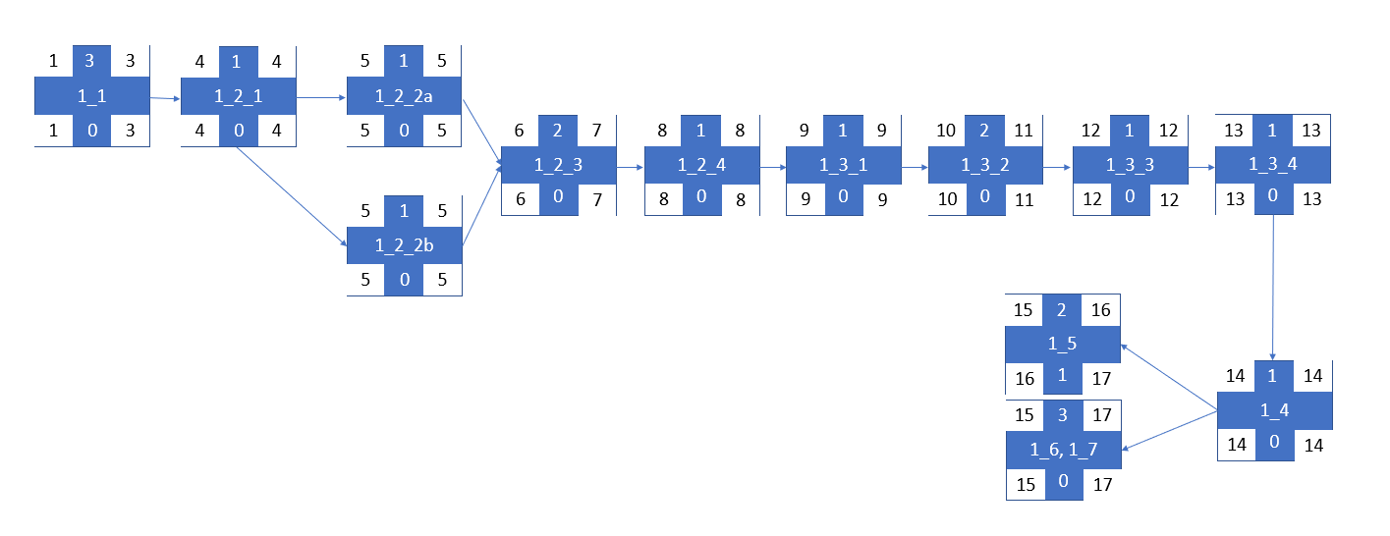
Critical Path for Iteration 1

Slide 12
Critical Path for Iteration 1
•1_1 ->1_2_1 -> 1_2_2->1_2_3 ->1_2_4 ->1_3_1 ->1_3_2 ->1_3_3 ->1_3_4 ->1_4 ->1_6, 1_7
•1_1 ->1_2_1 ->1_2_2b ->1_2_3 ->1_2_4 ->1_3_1 ->1_3_2 ->1_3_3 ->1_3_4 ->1_4 ->1_6, 1_7

Slide 13
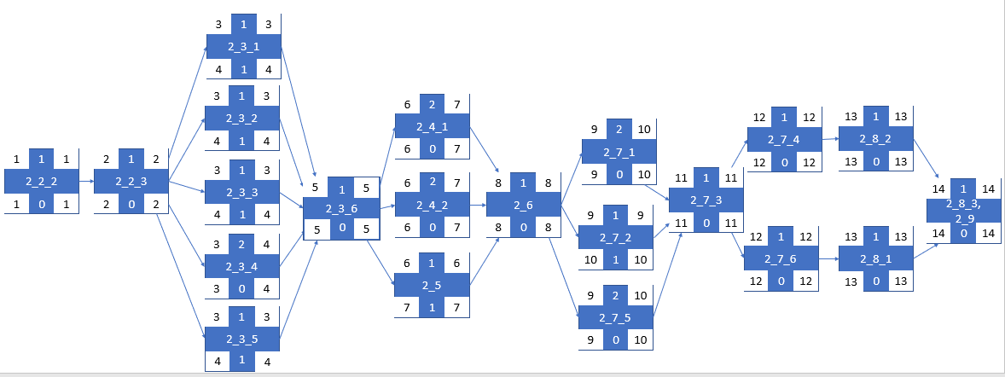
Critical Path for Iteration 2

Slide 14
Critical Path for Iteration 2
2_2_2 ->2_2_3 ->2_3_4 ->2_3_6 ->2_4_1 ->2_6 ->2_7_1 ->2_7_3 ->2_7_4 ->2_8_2 ->2_8_3, 2_9
2_2_2 ->2_2_3 ->2_3_4 ->2_3_6 ->2_4_1 ->2_6 ->2_7_5 ->2_7_3 ->2_7_4 ->2_8_2 ->2_8_3, 2_9
2_2_2 ->2_2_3 ->2_3_4 ->2_3_6 ->2_4_1 ->2_6 ->2_7_5 ->2_7_3 ->2_7_6 ->2_8_1 ->2_8_3, 2_9
2_2_2 ->2_2_3 ->2_3_4 ->2_3_6 ->2_4_1 ->2_6 ->2_7_1 ->2_7_3 ->2_7_6 ->2_8_1 ->2_8_3, 2_9
2_2_2 ->2_2_3 ->2_3_4 ->2_3_6 ->2_4_2 ->2_6 ->2_7_1 ->2_7_3 ->2_7_4 ->2_8_2 ->2_8_3, 2_9
2_2_2 ->2_2_3 ->2_3_4 ->2_3_6 ->2_4_2 ->2_6 ->2_7_1 ->2_7_3 ->2_7_6 ->2_8_1 ->2_8_3, 2_9
2_2_2 ->2_2_3 ->2_3_4 ->2_3_6 ->2_4_2 ->2_6 ->2_7_5 ->2_7_3 ->2_7_6 ->2_8_1 ->2_8_3, 2_9
2_2_2 ->2_2_3 ->2_3_4 ->2_3_6 ->2_4_2 ->2_6 ->2_7_5 ->2_7_3 ->2_7_4 ->2_8_2 ->2_8_3, 2_9

Slide 15
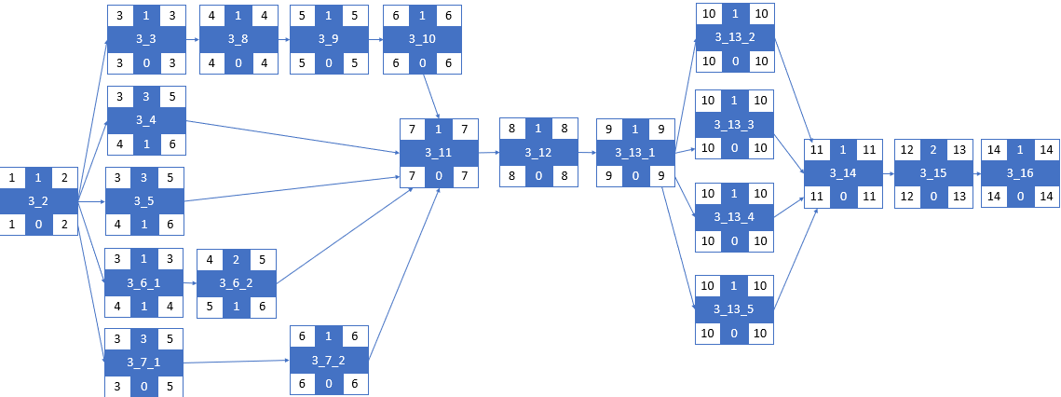
Critical Path for Iteration 3

Slide 16
Critical Path for Iteration 3
3_2 ->3_3 ->3_8 ->3_9 ->3_10 ->3_11 ->3_12 ->3_13_1 ->3_13_2 ->3_14 ->3_15 ->3_16
3_2 ->3_3 ->3_8 ->3_9 ->3_10 ->3_11 ->3_12 ->3_13_1 ->3_13_3 ->3_14 ->3_15 ->3_16
3_2 ->3_3 ->3_8 ->3_9 ->3_10 ->3_11 ->3_12 ->3_13_1 ->3_13_4 ->3_14 ->3_15 ->3_16
3_2 ->3_3 ->3_8 ->3_9 ->3_10 ->3_11 ->3_12 ->3_13_1 ->3_13_5 ->3_14 ->3_15 ->3_16
3_2 ->3_7_1 ->3_7_1 ->3_11 ->3_12 ->3_13_1 ->3_13_2 ->3_14 ->3_15 ->3_16
3_2 ->3_7_1 ->3_7_2 ->3_11 ->3_12 ->3_13_1 ->3_13_3 ->3_14 ->3_15 ->3_16
3_2 ->3_7_1 ->3_7_2 ->3_11 ->3_12 ->3_13_1 ->3_13_4 ->3_14 ->3_15 ->3_16
3_2 ->3_7_1 ->3_7_2 ->3_11 ->3_12 ->3_13_1 ->3_13_5 ->3_14 ->3_15 ->3_16

Slide 17
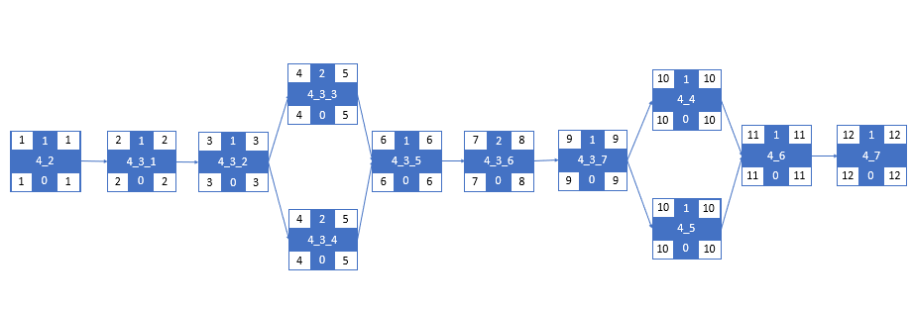
Critical Path for Iteration 4

Slide 18
Critical Path for Iteration 4
4_2 ->4_3_1 ->4_3_2 ->4_3_3 ->4_3_5 ->4_3_6 –> 4_3_7 ->4_4 ->4_6 ->4_7
4_2 ->4_3_1 ->4_3_2 ->4_3_3 ->4_3_5 ->4_3_6 –> 4_3_7 ->4_5 ->4_6 ->4_7
4_2 ->4_3_1 ->4_3_2 ->4_3_4 ->4_3_5 ->4_3_6 –> 4_3_7 ->4_4 ->4_6 ->4_7
4_2 ->4_3_1 ->4_3_2 ->4_3_4 ->4_3_5 ->4_3_6 –> 4_3_7 ->4_5 ->4_6 ->4_7

Slide 19
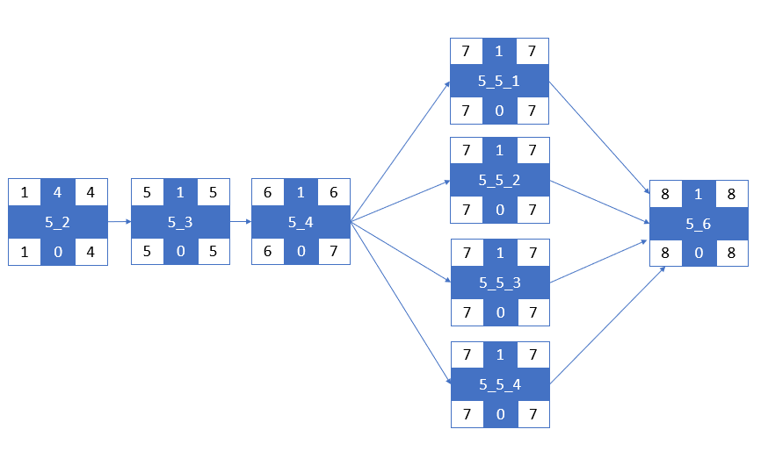
Critical Path for Iteration 5

Slide 20
Critical Path for Iteration 5
5_2 ->5_3 ->5_4 ->5_5_1->5_6
5_2 ->5_3 ->5_4 ->5_5_2 ->5_6
5_2 ->5_3 ->5_4 ->5_5_3->5_6
5_2 ->5_3 ->5_4 ->5_5_4->5_6

Slide 21
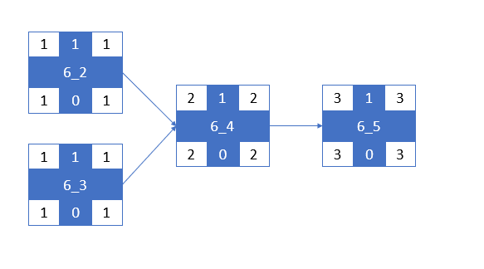
Critical Path for Iteration 6

Slide 22
Critical Path for Iteration 6
6_2 ->6_4 ->6_5
6_3 ->6_4 ->6_5

Slide 23
03
Bug Metrics

Slide 24
Bug Metrics
Total Bug Metrics up til 15/10/19 : 82
Bugs with 1 point were detected and solved immediately.
Mitigation: When more bugs with 5 points were detected, debugging session was scheduled on 11/10/2019 to meet and had discussion with the coders to resolve the bugs.

Slide 25
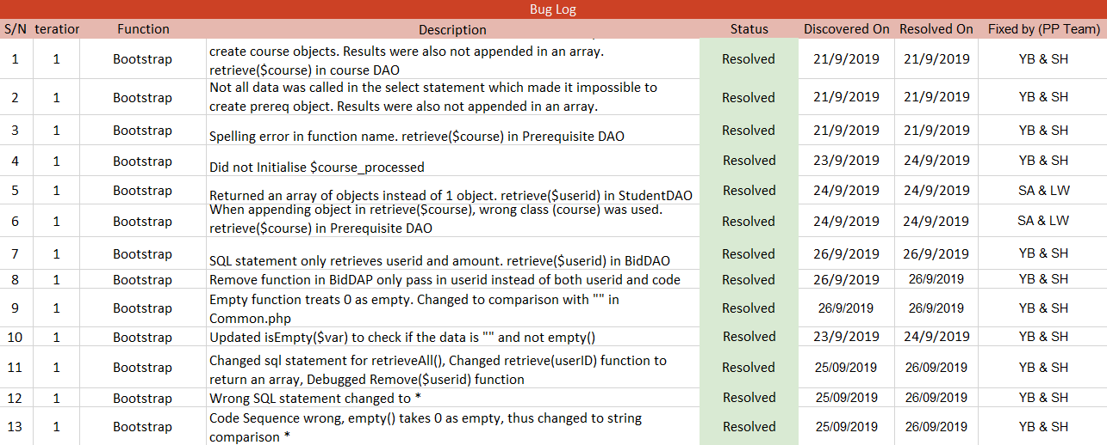

Slide 26
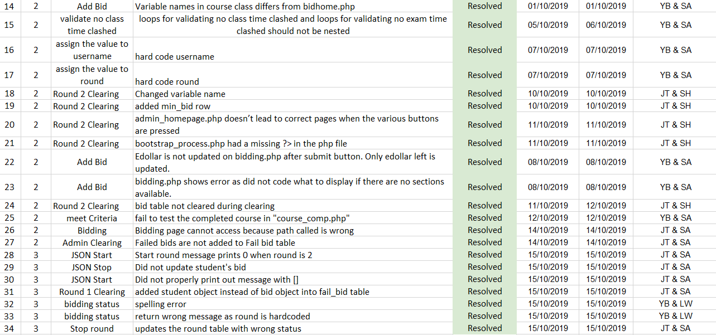

Slide 27
04
Roles and Responsibilities

Slide 28
Summary of Roles and Responsibilities
Milestone | PM | Coders | Coders
Ensure functionalities are up for PM Review | Jaslyn | See Hoe, Yi Bing | Leonard, Serene
1 - PM Review | Leonard | Jaslyn, See Hoe | Yi Bing, Serene
2 - Application Demo and Progress Update | See Hoe | Serene, Jaslyn | Yi Bing, Leonard
3 - UAT | Serene* | Jaslyn, Leonard | *Yi Bing, See Hoe
4 - Submission | Yi Bing* | *Jaslyn, Serene | Leonard, See Hoe
5 - Final Presentation | Jaslyn | See Hoe, Yi Bing | Leonard, Serene

Slide 29
Iteration 1: Responsibilities
Roles | Roles Description / Tasks | Assigned Member
Project Manager | Daily Updates Schedule Planning for all Iterations Manage Schedule Prepare team for PM Review | Jaslyn
Pair 1 | Bootstrap for Section, Course, Prerequisites Login | See Hoe, Yi BIng
Pair 2 | Bootstrap for Bid, Course_completed, Student | Serene, Leonard

Slide 30
Iteration 2: Responsibilities
Roles | Roles Description / Tasks | Assigned Member
Project Manager | Daily Updates Manage Schedule Ensure commits are on time Prepare for PM Review | Leonard
Pair 1 | Round 1 & 2 Starting and Clearing Admin Page JSON Login, Bootstrap, Dump Table, Start round, Stop round | Jaslyn, See Hoe
Pair 2 | Round 1 & 2 Bid for ->section Student Bid Page | Serene, Yi Bing

Slide 31
Iteration 3: Responsibilities
Roles | Roles Description / Tasks | Assigned Member
Project Manager | Daily Updates Schedule Planning for all Iterations Manage Schedule and ensure team is ready for UAT | See Hoe
Pair 1 | Drop ->bid JSON Login, Bootstrap, Start, Stop Update Bid, Drop Section JSON Dump table, Drop Section, Dump (User), Dump (Bid), Dump (Section) | Jaslyn, Serene
Pair 2 | View Bidding results Drop ->section | Yi Bing, Leonard

Slide 32
Iteration 4: Responsibilities
Roles | Roles Description / Tasks | Assigned Member
Project Manager | Daily Updates Schedule Planning for all Iterations Manage Schedule and ensure team is ready for UAT | *Serene
Pair 1 | Testing: Round 1 and 2 Bidding and clearing | Jaslyn, Leonard
Pair 2 | Testing: Login and Bootstrap | *See Hoe, Yi Bing

Slide 33
Iteration 5: Responsibilities
Roles | Roles Description / Tasks | Assigned Member
Project Manager | Daily Updates Schedule Planning for all Iterations Manage Schedule and ensure team is ready for Final Submission | *Yi Bing
Pair 1 | Prepare slides for Final Presentation | *Jaslyn, Serene
Pair 2 | Prepare slides for Final Presentation | Leonard, See Hoe

Slide 34
Iteration 6: Responsibilities
Roles | Roles Description / Tasks | Assigned Member
Project Manager | Daily Updates Schedule Planning for all Iterations Manage Schedule and ensure team is ready for Final Presentation | Jaslyn
Pair 1 | Prepare slides and demo for Final Presentation | Yibing, See Hoe
Pair 2 | Prepare slides and demo for Final Presentation | Leonard, Serene

Slide 35
05
Pair Programming and Rotation Plan

Slide 36
Pair programming teams and rotation plan
Pair 1 | Iteration | Pair 2
See Hoe, Yi Bing | 1 | Leonard, Serene
Jaslyn, See Hoe | 2 | Yi Bing, Serene
Serene, Jaslyn | 3 | Yi Bing, Leonard
Jaslyn, Leonard | 4 | *Yi Bing, See Hoe
*Jaslyn, Serene | 5 | Leonard, See Hoe
See Hoe, Yi Bing | 6 | Leonard, Serene

